Slide 1


Types of Events
Seen in MINERvA

Slide 2
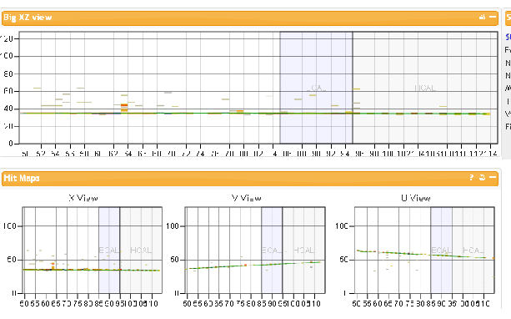
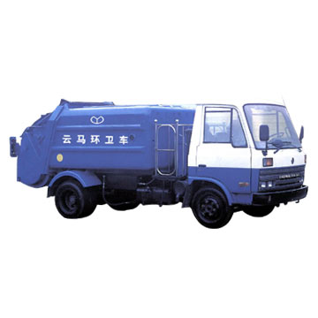
A Single Particle Event
Here a single particle travels the full length of the detector. You can see it enter the left end of the screen and exit the right. It went right on through the detector and kept going!

Slide 3
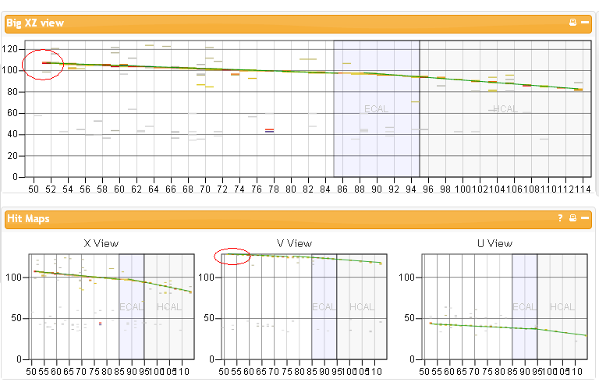
Particle Enters From Top Corner
Here the particle enters the top left corner of the detector and exits the end. You can see a gap in the top XZ view before entering the detector. Also, look in the bottom V View. You can see the particle entering the top.

Slide 4
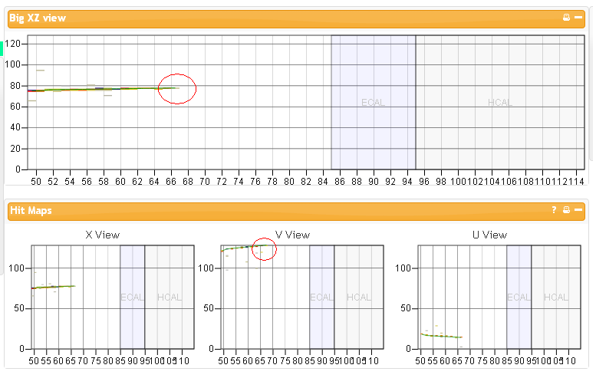
Particle Enters Front of Detector Then Exits Side
Here you can see the particle entering the front of the detector and then what looks like stopping in the detector in the XZ view. However, a closer look in the V View will show you that it also exited the side.

Slide 5
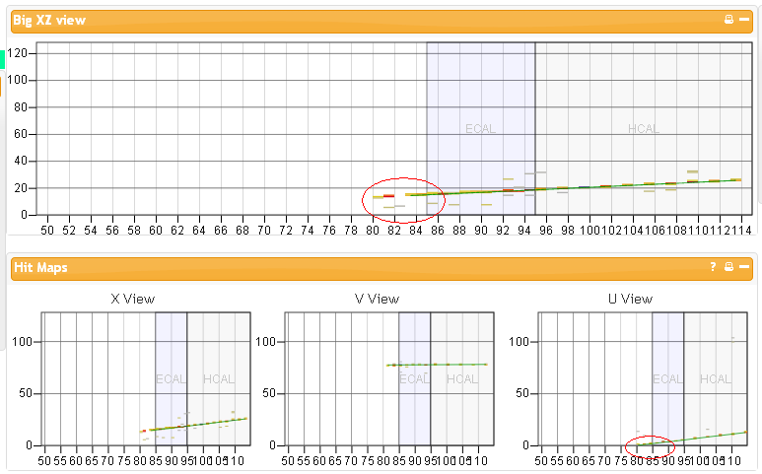
Particle Enters the Bottom and Exits End
Here the particle seems to appear right in the middle of the detector. However, it actually enters the bottom. You can see it enter in the U View.

Slide 6
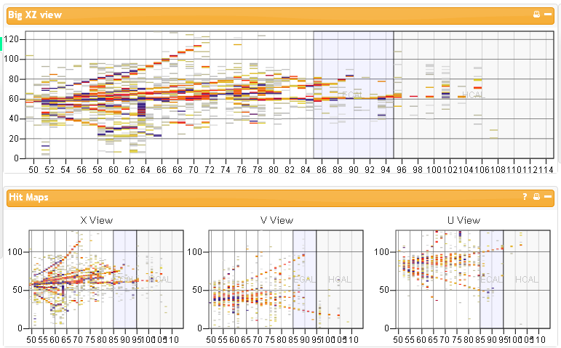

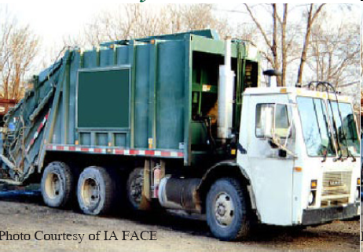

A Shower
Before entering MINERvA the beam travels through a large area of rock.
This event was probably created by a particle interacting with a nucleus of an atom in that rock. This generated a number of tracks from other particles. This type of display is called a shower. We often state that this is a “splashy” event.

Slide 7
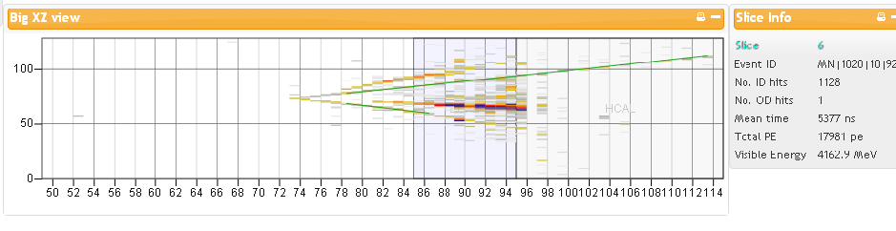
Another Splashy Event
Here is a pi-zero (π⁰) particle decaying into two photons and two other particles. A π⁰ is just a special type of pion. The two particles given off are probably a muon and a pion.

Slide 8
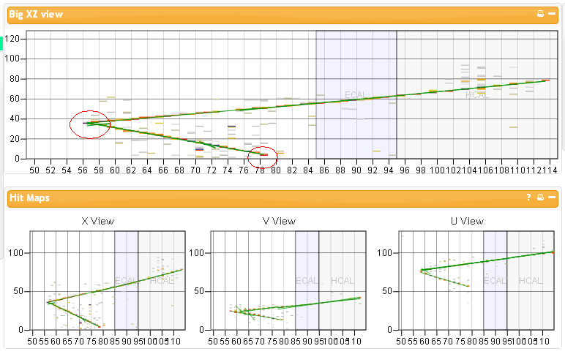
An Invisible Particle Gives Off Two Particles
MINERvA can only detect particles with energy. In general, they need to either have a charge or be moving. Here, a neutral particle interacts with a nucleus in the detector. You can see the beginning of the track where it branches off into two paths. One of the particles exits the bottom of the detector and the other one exits the end.

Slide 9
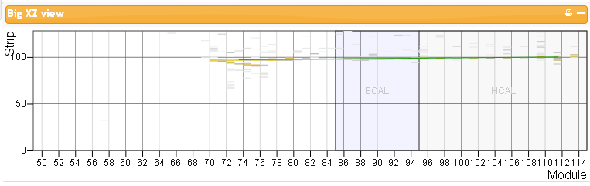

The Invisible Neutrino Billiard Ball Event
In this “quasi” elastic event, an invisible neutrino enters the detector and strikes a neutron. The neutrino then changes into its electrically charged partner the muon. The neutron changes into a proton.

Slide 10
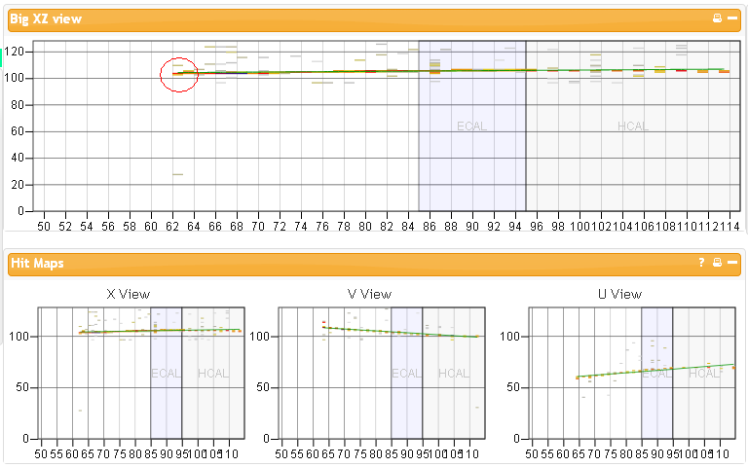
Particle is Created in Detector
A single particle is generated in the detector. It was probably created by a neutrino interacting with a particle in the detector transferring momentum to that particle. You can see the second particle moving out of the detector.

Slide 11
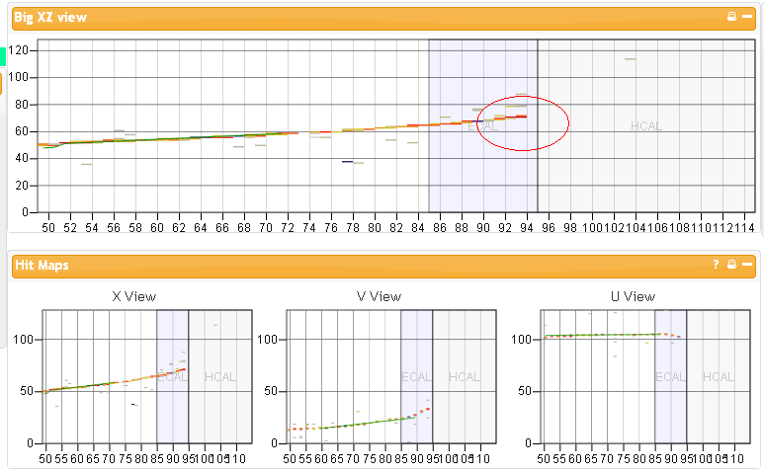
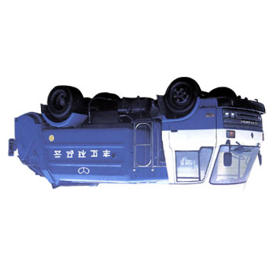
Particle Enters Front and “Dies” in Detector
Here the particle enters the front and simply stops in the detector. As the particle travels in the detector, it transfers energy to the detector. This particle simply ran out of energy and its track stops in the ECAL section of the detector.

Slide 12
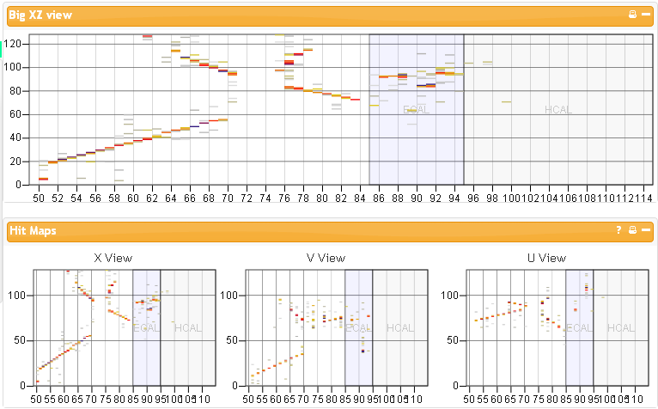
Four Particles Are Generated!
Here you can see four particles going off in different directions.

Slide 13
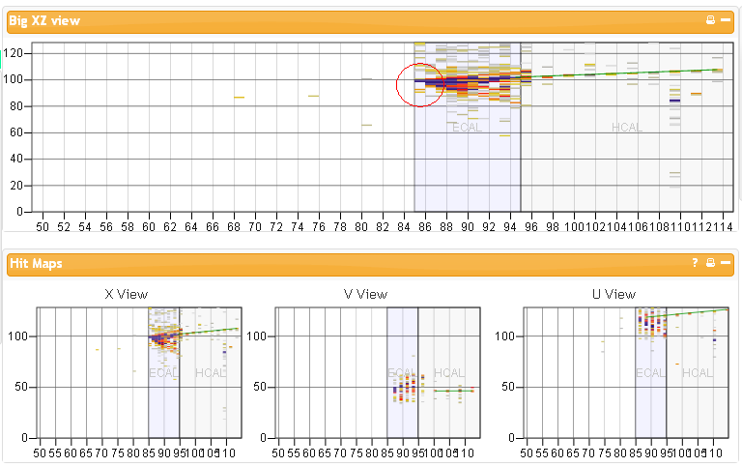
Interaction in the ECAL
Here you can see the particles being generated a the beginning of the ECAL. A splashy event is generated as well as another particle that exits the end of the detector.

Slide 14
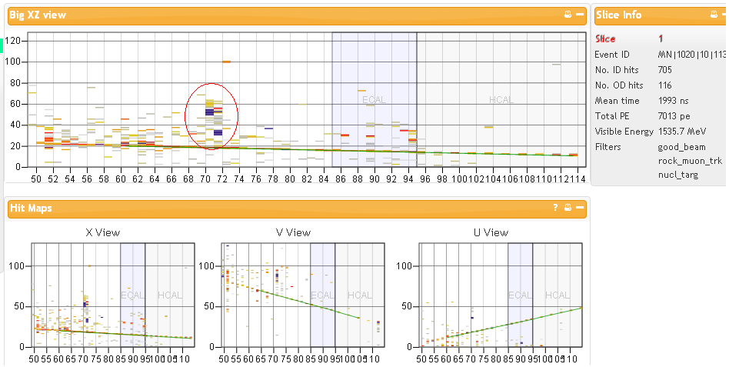
Large Energy Source
Here is a large energy source. You can tell it has lots of energy because of the dark colors. The next slide you will see the result of this energy source.

Slide 15
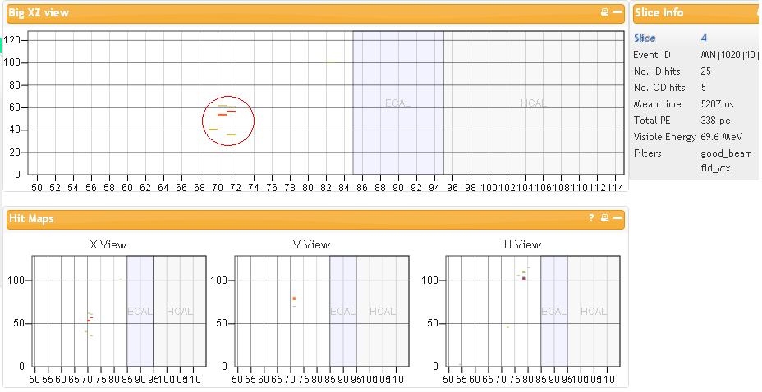

An Electron is Given Off!
Here an electron has been given off. You can tell it is an electron due to its short track and small energy. You can tell it was from the large energy source due to its placement in the detector. It starts at about 70 – right where the energy source had appeared.

Slide 16
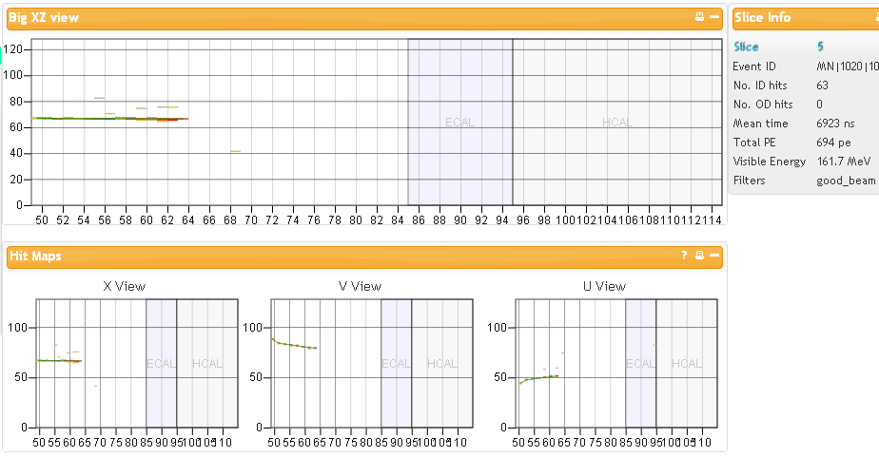
A Muon
This is probably a muon. It enters on the left and dies in the detector. Notice where the track ends. The next slide will show the electron emitted at that same spot in the detector.

Slide 17
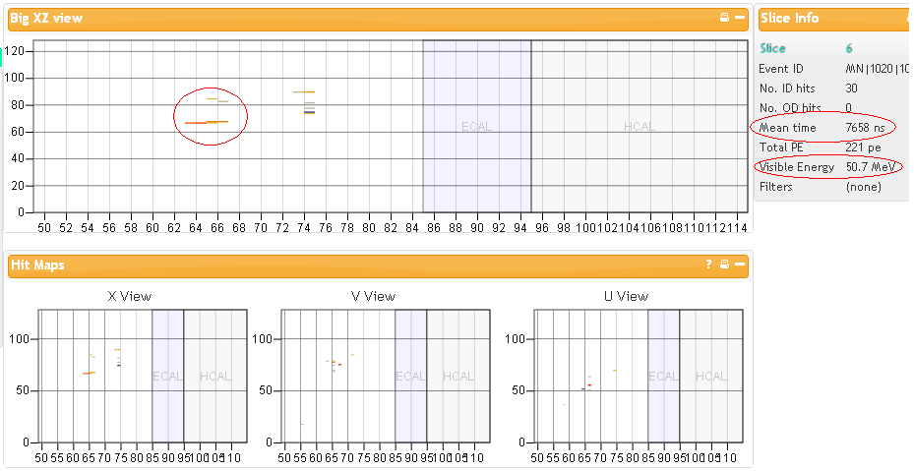

The Emitted Electron
Here you can see the electron which was emitted. In your activity, you will be asked to analyze data from such events. You can see the mean time and visible energy amounts in the slice info section.

Slide 18

How Was the Electron Created?
As seen earlier, many neutrinos produce muons in their final state.
Sometimes the muons are created in the rock layer outside of the detector.
Due to their relatively long lifetime and their ability to pass through material without losing much energy, they usually just travel right on through MINERvA.
If they do stop, they usually decay as in the following reactions:
The neutrinos in the interaction usually don’t interact with anything in the detector so they are invisible.
Usually we only see the electron emitted.
We usually don’t see any negatively charged muons either since they are captured by nuclei.

Slide 19
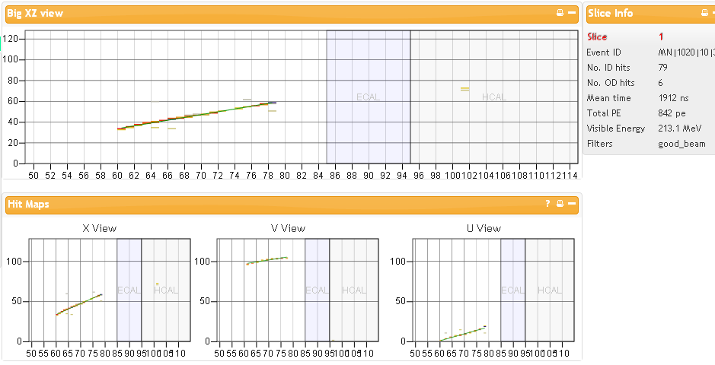
The Muon Enters
The muon enters the detector on the bottom. It then dies in the detector. Look at the next 3 slices and see if you can find the electron.

Slide 20
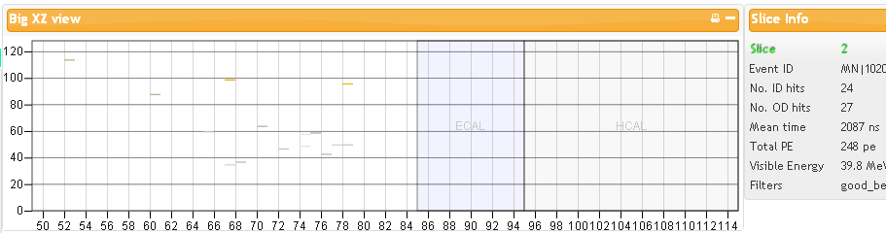
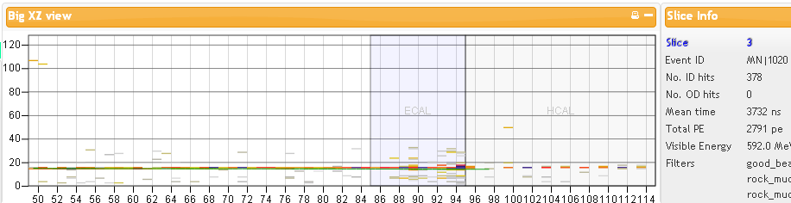
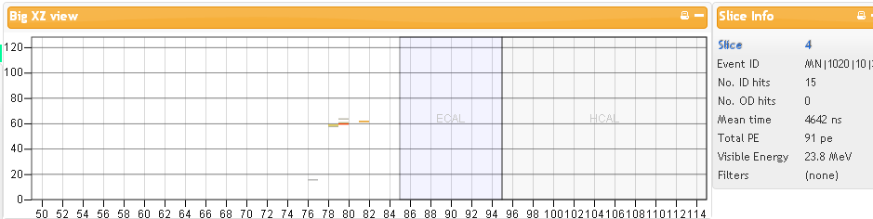
Find the Electron in These Slices:

Slide 21
Sometimes the electron does not reveal itself in the detector right away. It may be a few slices away. You can think of slices as separate windows of events which happened in the detector. Look at slice 3. The detector shows another particle traveling through before the electron had been emitted. In the next slice you see the electron.
By using the mean time of the slice with the electron and subtracting the mean time of the slice with the muon, we can find how long it took to emit the electron. We will be using this unit of time to determine the half-life of a muon.

Slide 22
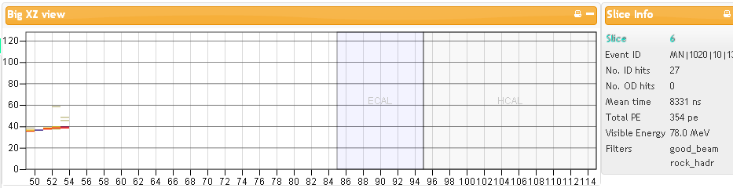
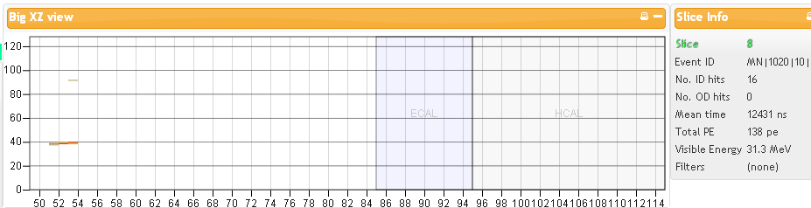
Electron Emitted Backwards
Sometimes the electron is emitted in what we consider the backwards direction. Keep in mind that when the muon decays, it is at rest. The electron can be emitted in any direction. Just make sure the beginning of the electron’s track matches up with the end of the muon in the previous slice.

Slide 23
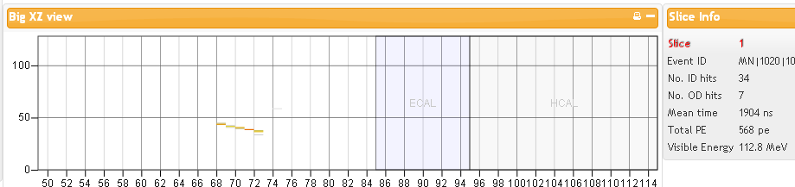
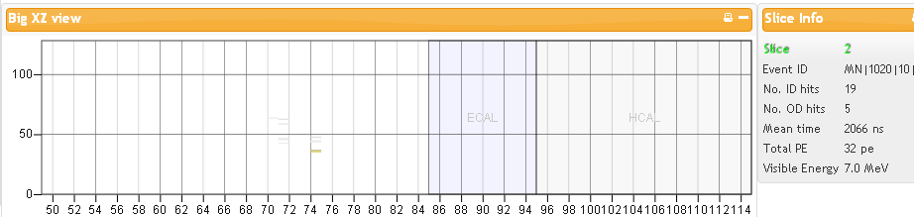
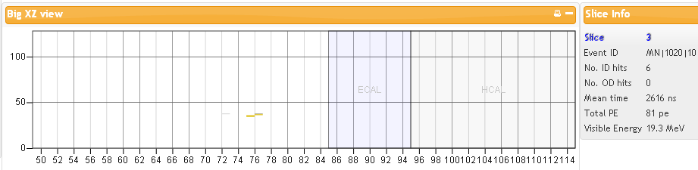
A Decaying Pion
Here you can see three consecutive slices in which a particle decays producing two different particles – one in each of the two next slices. This could possibly be a pion decaying into a muon and then into an electron.

